Slide 1
SLEDS for Sockeye?
Currently:
The issue:
2.4.2.11. SLEDs. Sea Lion Exclusion Devices (SLEDs) will be at all adult fishway entrances and all floating orifice gates (FOGs).
iii. All other entrance SLEDs will be raised by June 1 for adult sockeye passage and lowered by July 20, or as soon as possible if a sea lion is observed in the fishway.
Sea Lions
  Since 2012, the number of Stellar Sea Lions returning to and staying at Bonn has increased, wherein the average number of animals at the end of July was 10.2.
  -Kyle Tidwell, et al.

Slide 2
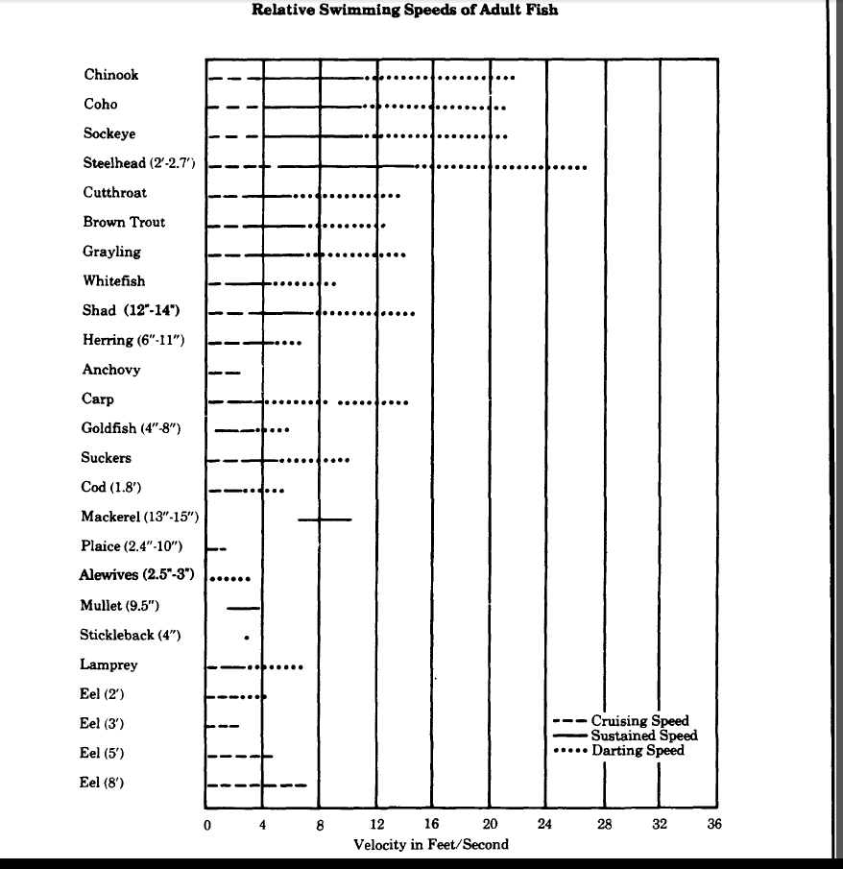
According to Milo Bell:

Slide 3
10 Years of Tailwater at a Glance

Slide 5
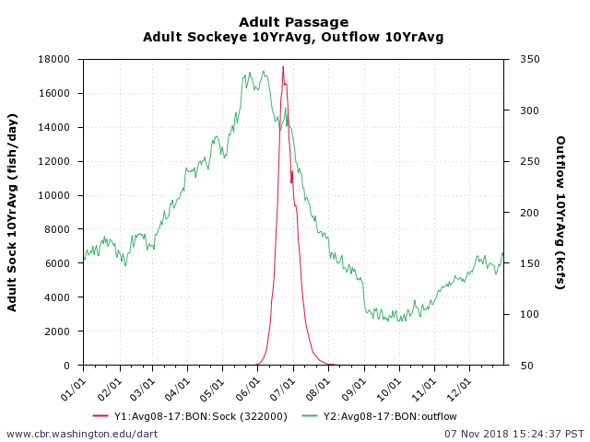
Average Tailwater Levels vs Sockeye
Note: outflow does not directly correspond to tailwater levels.

Slide 6
Model Imagery
All of the images used for comparison below are taken from Configuration 2 of “Computational Fluid Dynamics Modeling of the Washington Shore Fish Ladder Entrance Modifications at Bonneville Dam”.
Configuration 2 includes the two entrances to the Lamprey Flume System (LFS).
An axis key is shown in the image to the right.
5-2
Pg 64

Slide 7
NDE overhead view @ 10ft
I-4
Pg 159
G-4
pg 141

Slide 8
NDE @ 10ft side view With SLED
A-7

Slide 9
NDE @ 10ft side view No SLED
G-7
Pg 144

Slide 10
NDE @ 18ft
5-13
Pg 79
Overhead
view
5-6

Slide 11
NDE side view @ 18ft With SLED
5-16
Pg 82

Slide 12
NDE side view @ 18ft No SLED
5-9
Pg 73

Slide 13
NDE overhead view @ 28’
At tailwater 28’, all of the examined models show reduced entrance velocities with SLED vs without SLED.
H-4 pg 150
J-4 pg 168

Slide 14
NDE side view W/ SLED @ 28ft
J-7 pg 171

Slide 15
NDE side view No Sled @ 28 ft
H-7 pg 153

Slide 16
Citations
Fisheries Handbook of Engineering Requirements and Biological Criteria. Fish Passage Development and Evaluation Program
Corp of Engineers, North Pacific Division, Portland Oregon, 1990
Milo C. Bell
Computational Fluid Dynamics Modeling of the Washington Shore Fish Ladder Entrance Modifications at Bonneville Dam. Corp of Engineers, Portland District, Portland Oregon, 2010. Through AECOM and INCA Engineers, Inc.
Evaluation of Pinniped predation on adult Salmonids and other fish in the Bonneville Dam Tailrace, 2018. Corps of Engineers, Portland District, Fisheries Field Unit. Tidwell et all.

